Slide 1
FFT preprocessing

Slide 2
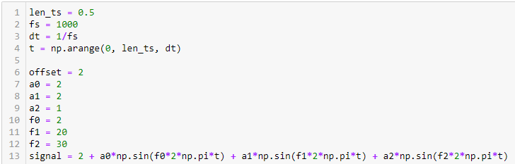
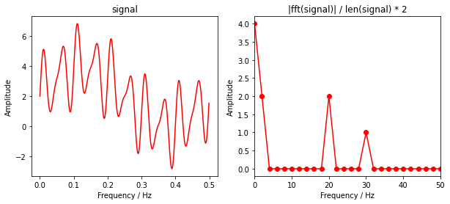
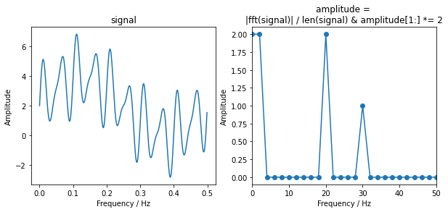
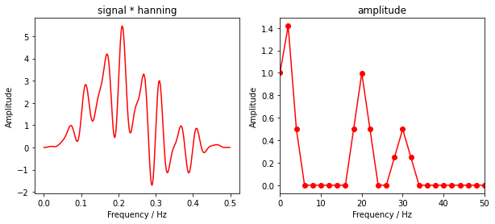
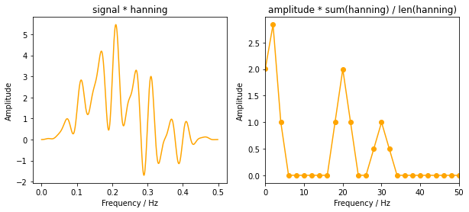
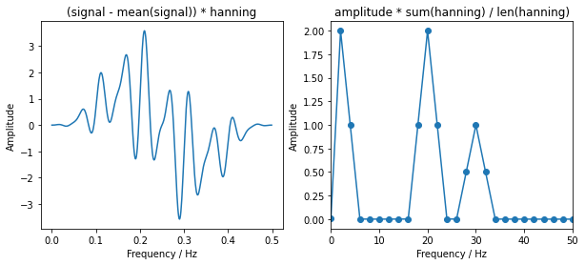
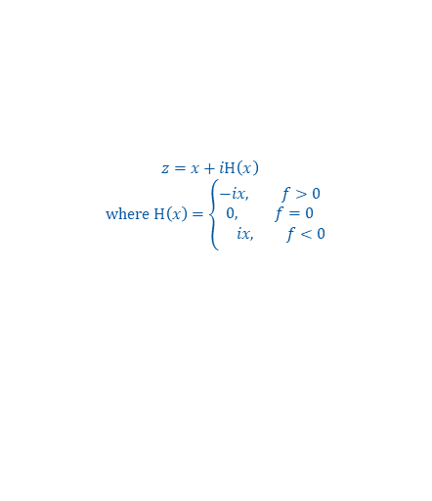
FFT Toy Example
Apply Hilbert transform: Multiply all but first sample of fft amplitude with 2
$z=x+iH\left(x\right)$
$$where H\left(x\right)=\left\{\begin{aligned}−i&x, f>0 \\ 0, f=0 \\ &ix, f<0\end{aligned}\right.$$
Add Window gain: Divide all signals with sum(window)/len(window)
Subtract dc component:
Smearing of dc component interferes with low frequency component

Slide 3
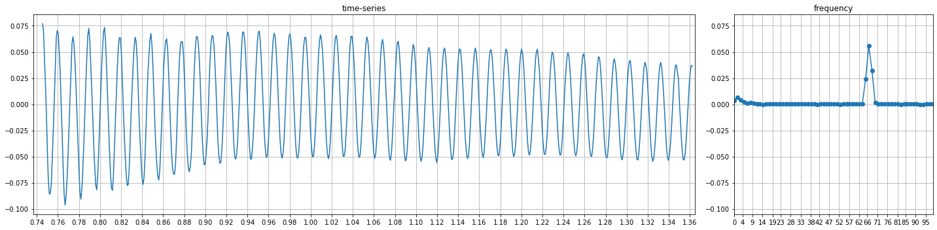
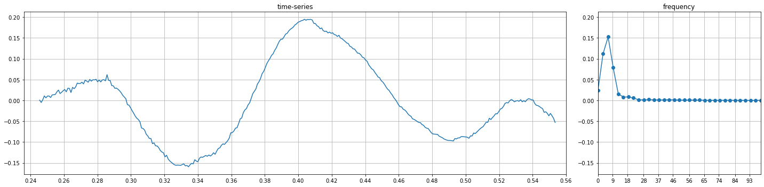
Examples with applied Hilbert transform, window gain (hanning), linear detrend
f = 1 / 0.06s * 4 periods = 66.6 Hz
f = 1 / 0.16s = 6.25 Hz

Slide 4
Windowing

Slide 5
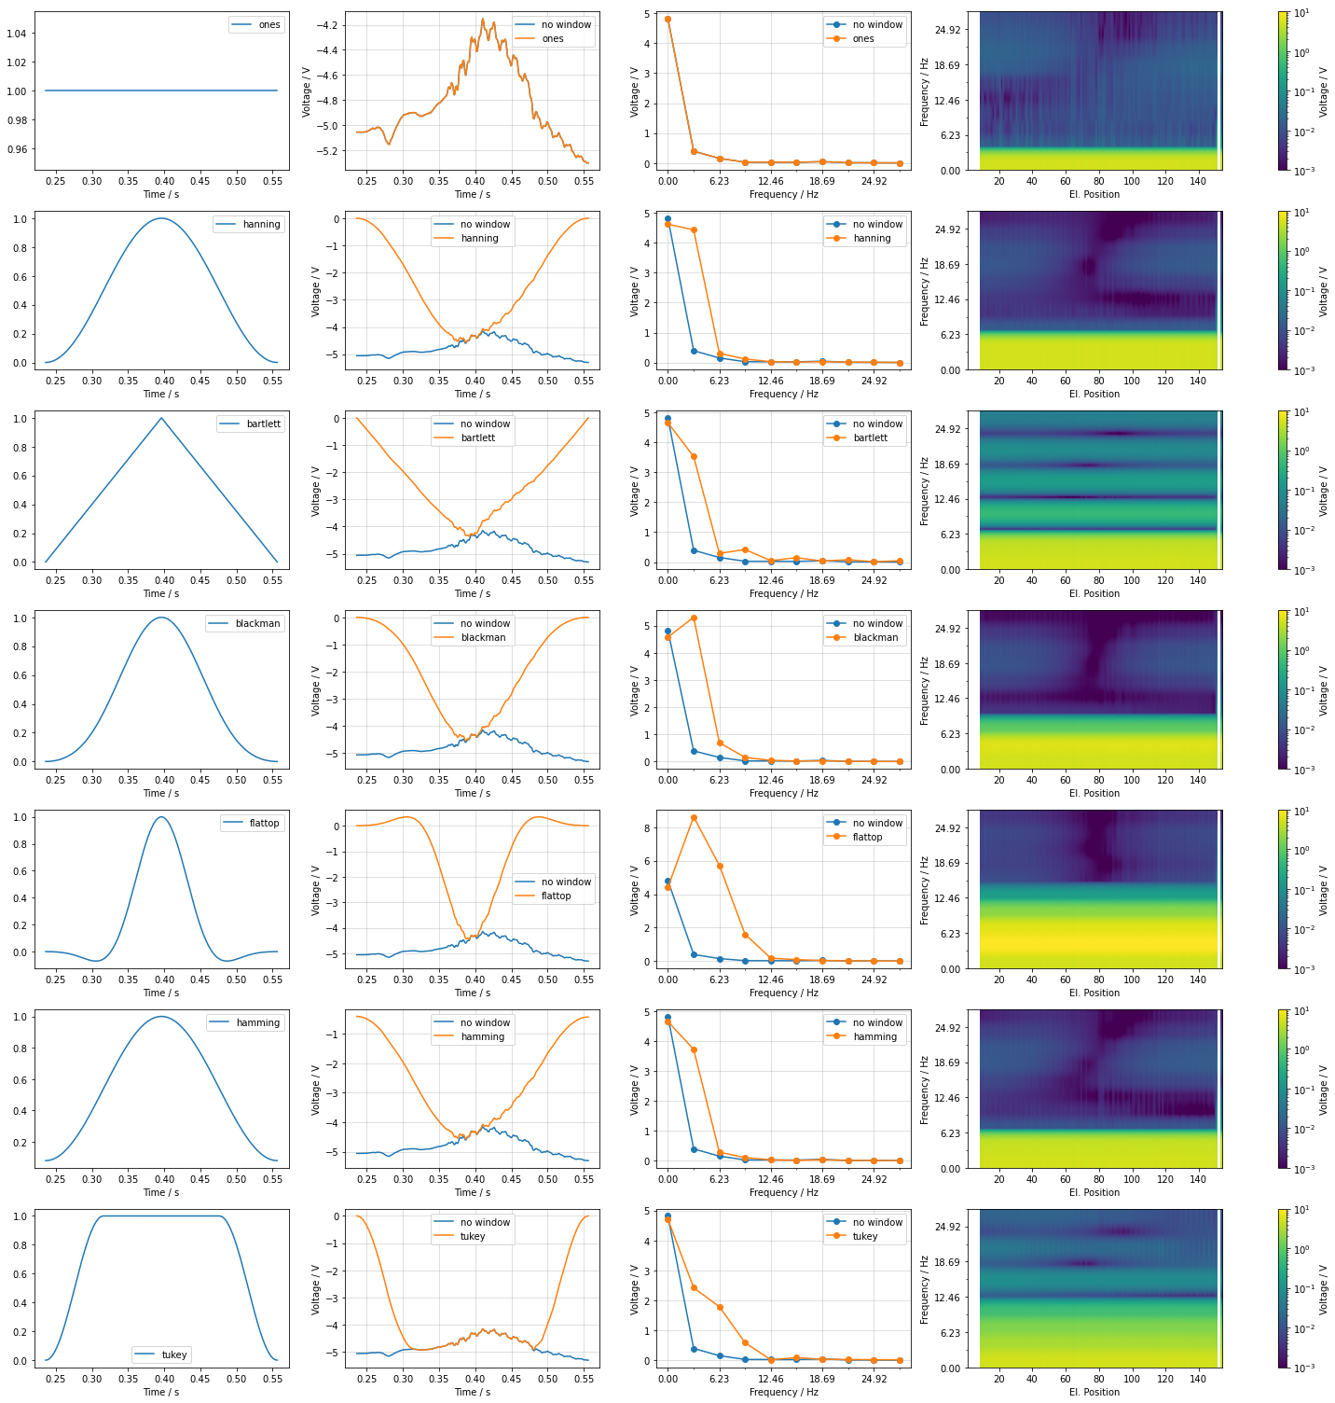
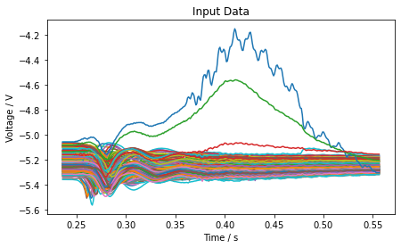
No preprocessing

Slide 6
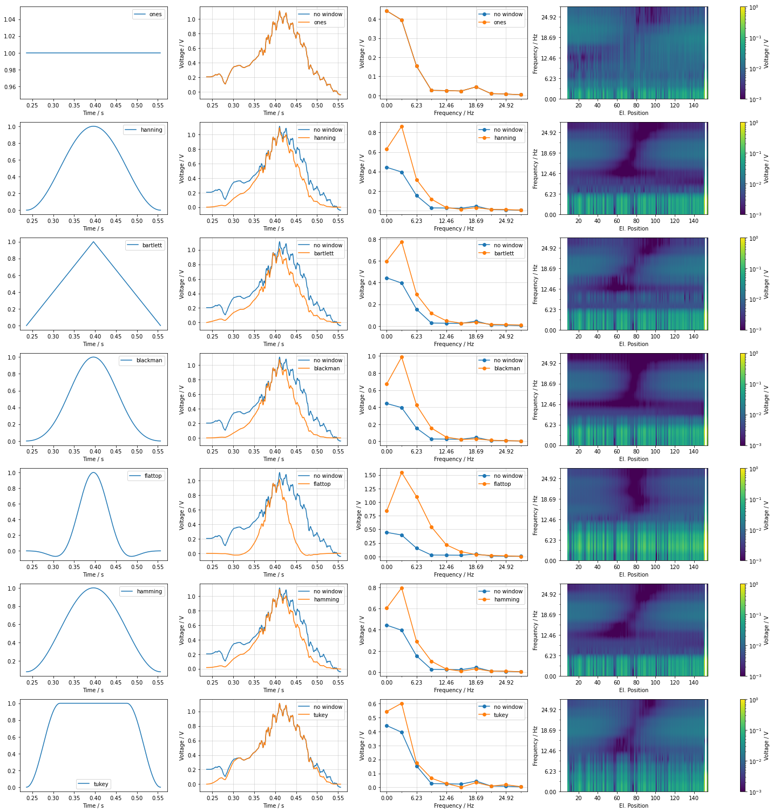

Subtract mean dim=“el_position”

Slide 7
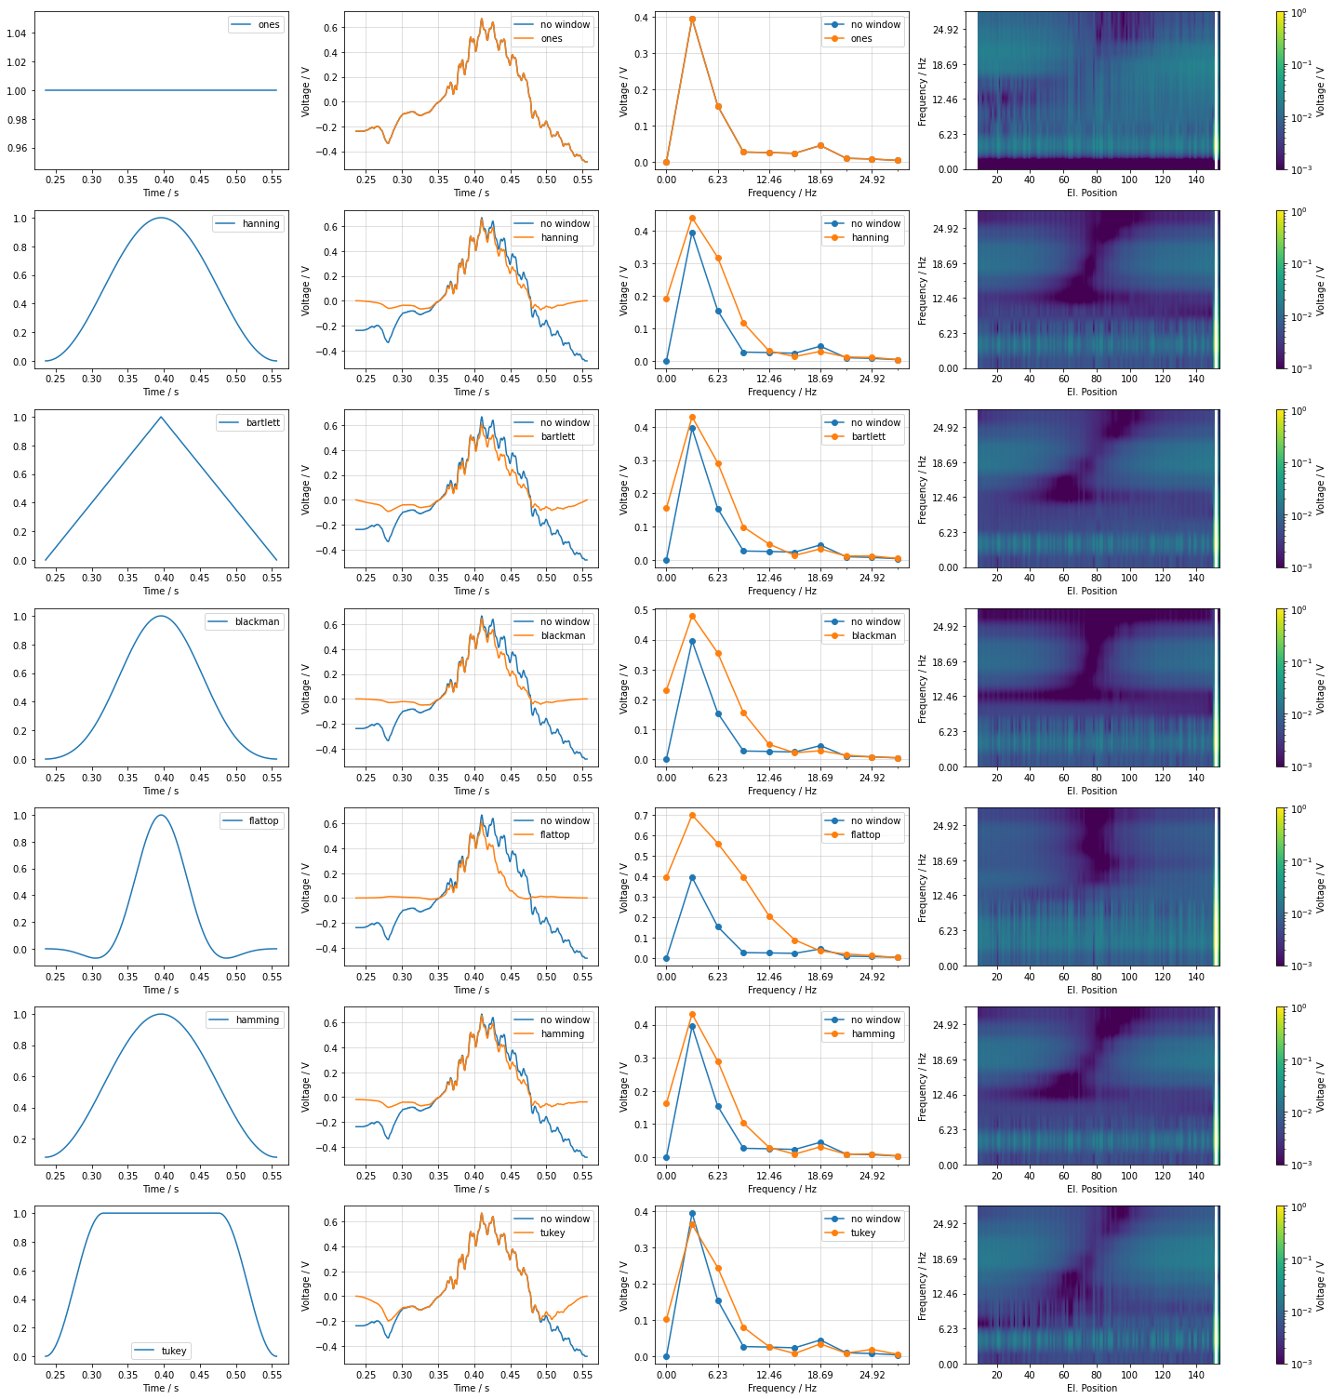
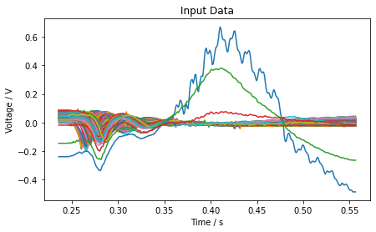
Subtract mean dim=“time”

Slide 8
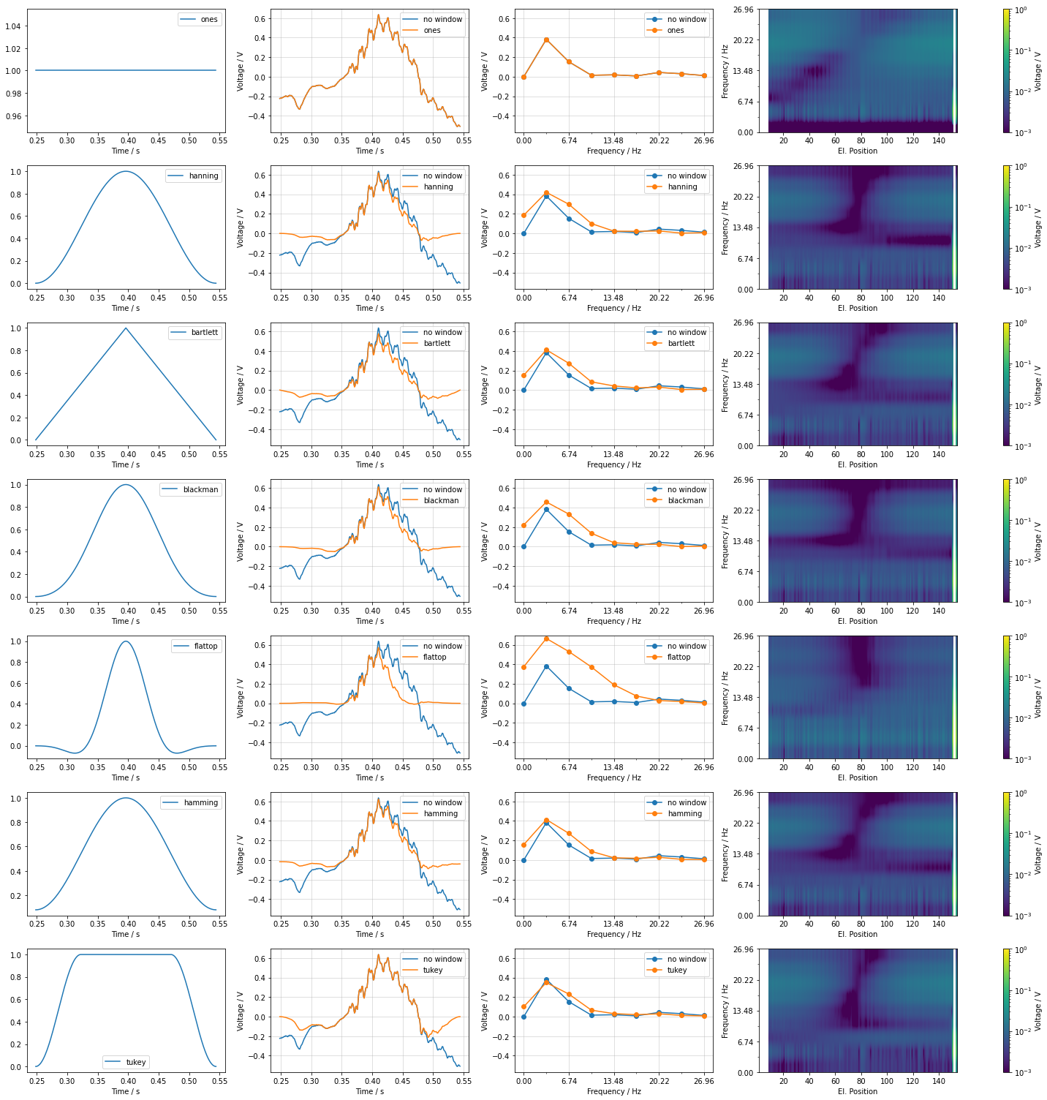
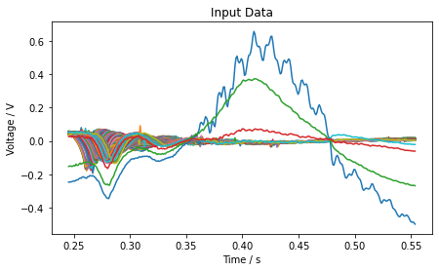
Detrend

Slide 9
Reconstruction of time series

Slide 10
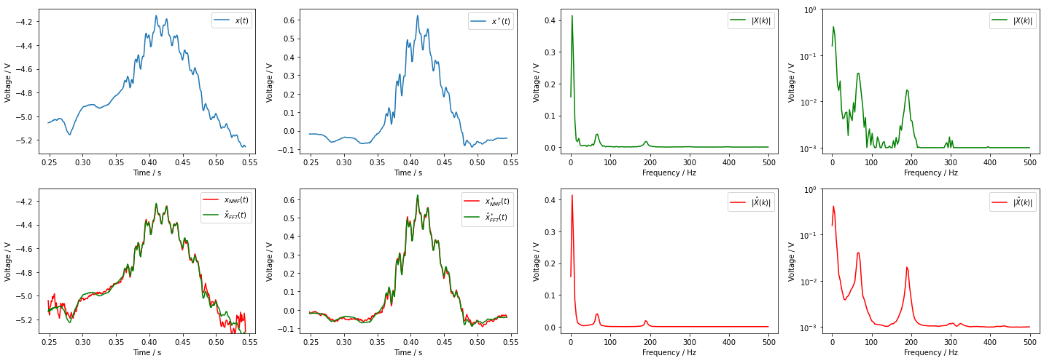
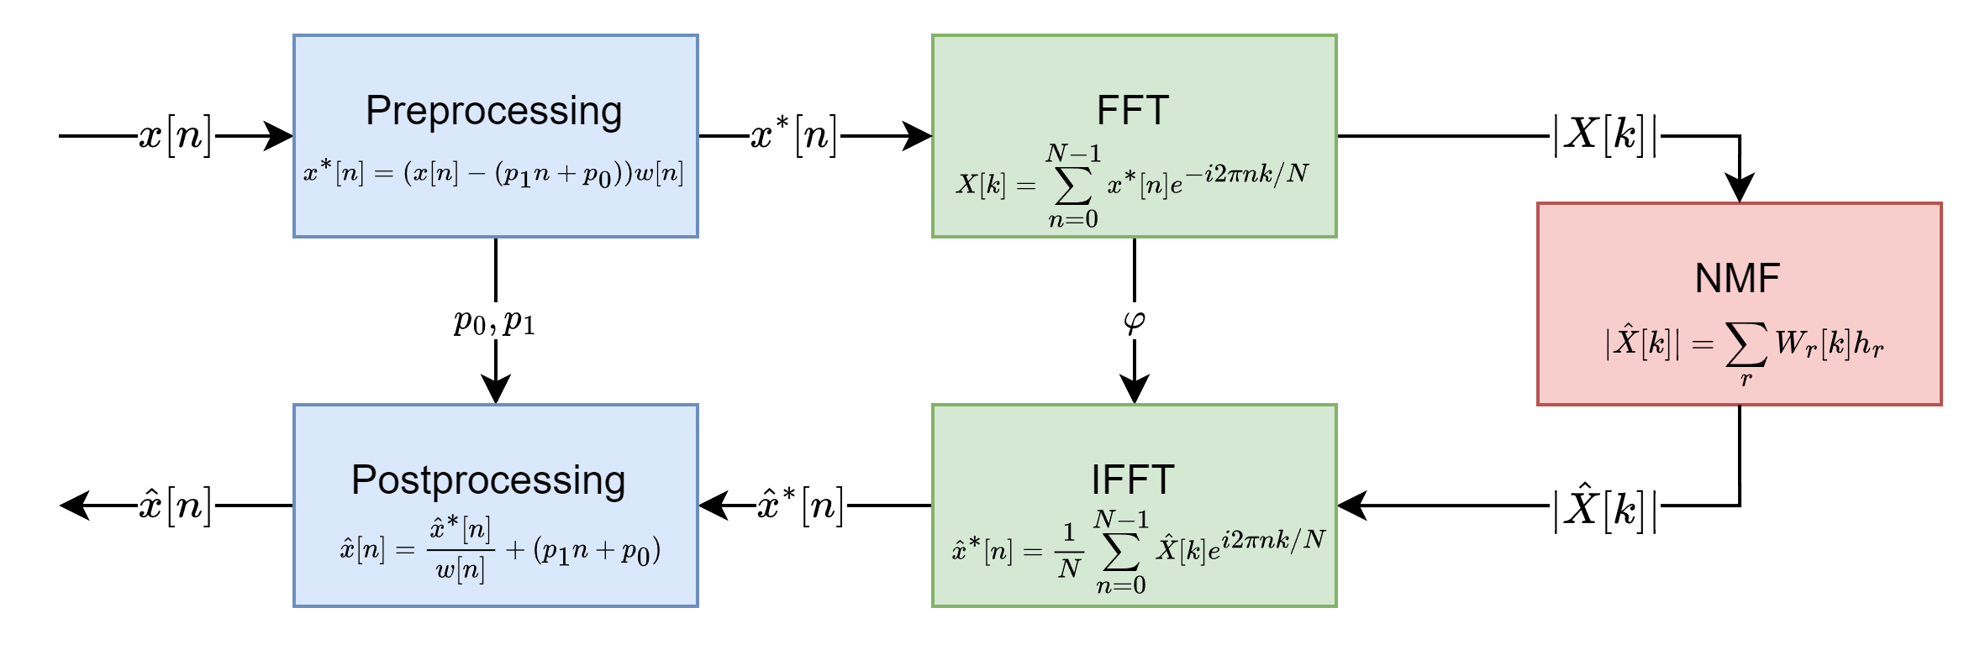
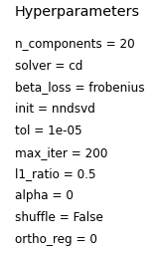
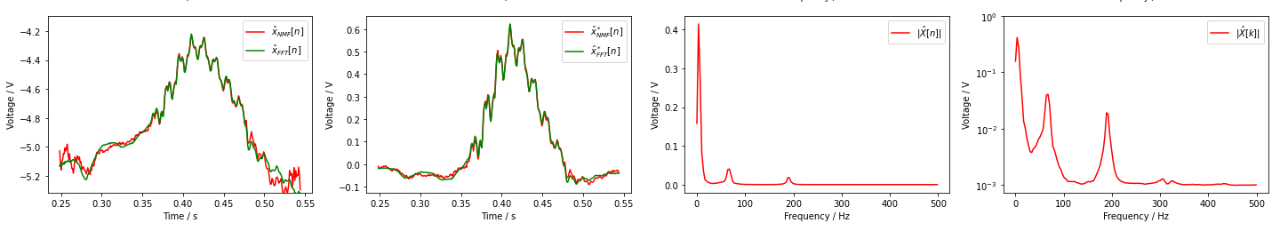

Slide 11
Anomaly detection
Frequency range: 0Hz – 500Hz
Voltage range: 1e-3V – 1V

Slide 12
